Slide 1
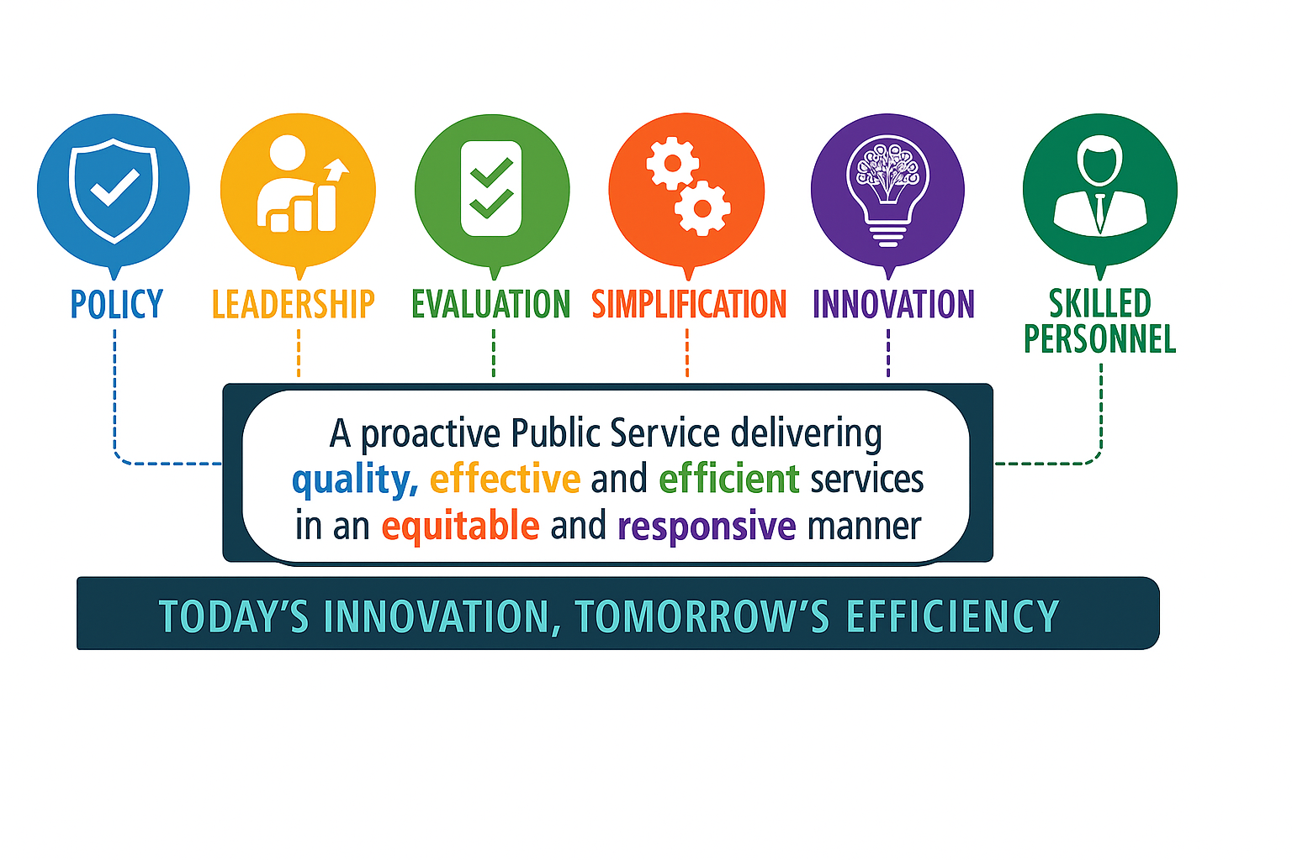
DPSM
The DPSM is the primary government agency responsible for driving Saint Lucia’s digital transformation. Through Cabinet Conclusion No. 642 of 2013, the DPSM’s mandate was broadened to lead the digital transformation of Saint Lucia’s public service.

Slide 2
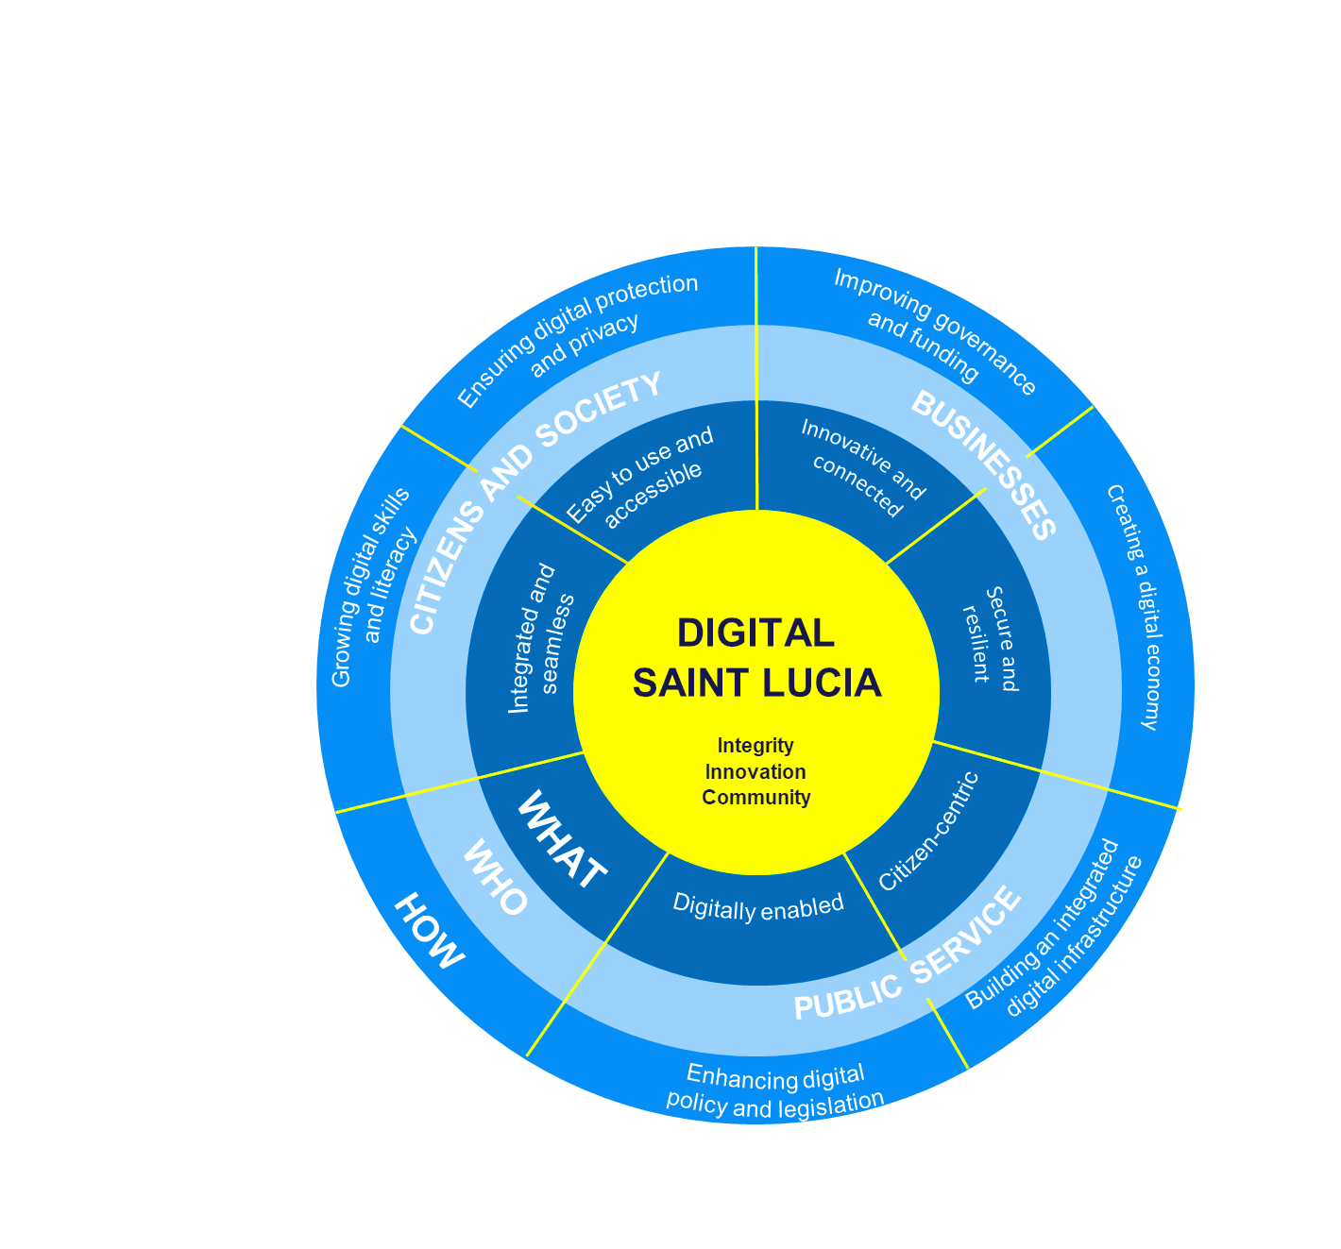
Saint Lucia Digital Development Strategy
A transformed and equitable society that fully leverages Digital Technologies to propel innovation, national development and global competitiveness, with a resilient economy and good governance as its foundation.
Digital Enabling Environment
Digital Government Infrastructure, Platforms and Services
Digital Skills and Technology Adoption

Slide 3
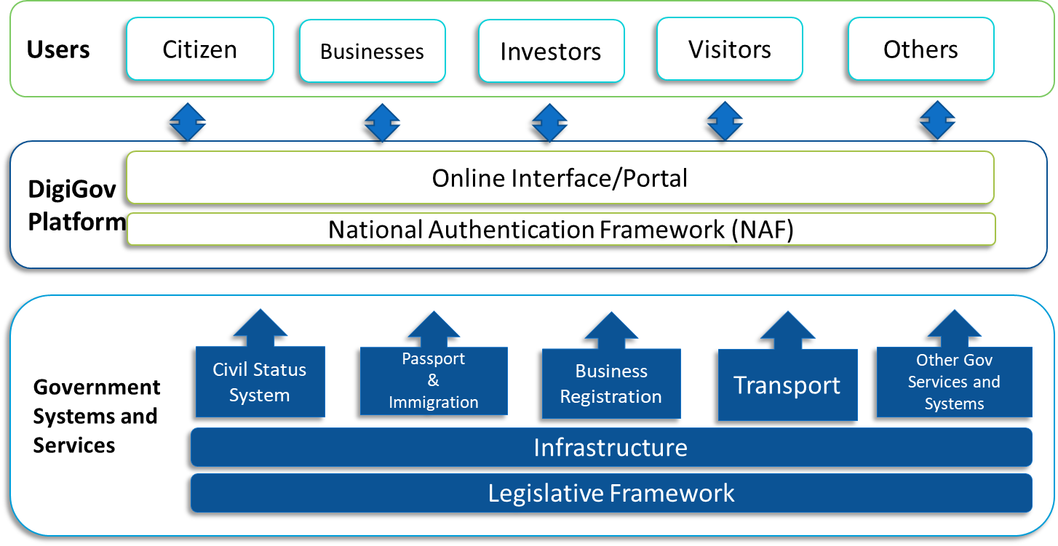
What Are We Trying To Achieve?
Revolutionizing Identity Management with the National Authentication Framework (NAF) & GOSL Digital ID Platform
Unlock a seamless and secure way to engage with GOSL through a secure identity management solutions:
Digital Citizens
Identity as a Service – A streamlined and efficient approach to digital identity.
Advanced Identity Management:
  Seamless Access: Use a single authentication device to securely log in to multiple online services.
  Trust & Confidence: Strengthening digital trust through robust security measures.
  Enhanced Protection: Safeguarding users against identity theft and cyber threats.
Modernizing Government Operations:
  Standardizing government services for greater efficiency.
  Expanding decentralized access to improve service availability.
  Boosting operational efficiency with a shared service platform.
Building a Smarter Digital Future:
  Strengthening the digital ecosystem for innovation and growth.
  Cultivating trust in government data and digital services.
  Taking a bold stand against corruption through transparency and accountability.
Empowering citizens and businesses with a secure, efficient, and trusted digital identity.

Slide 4
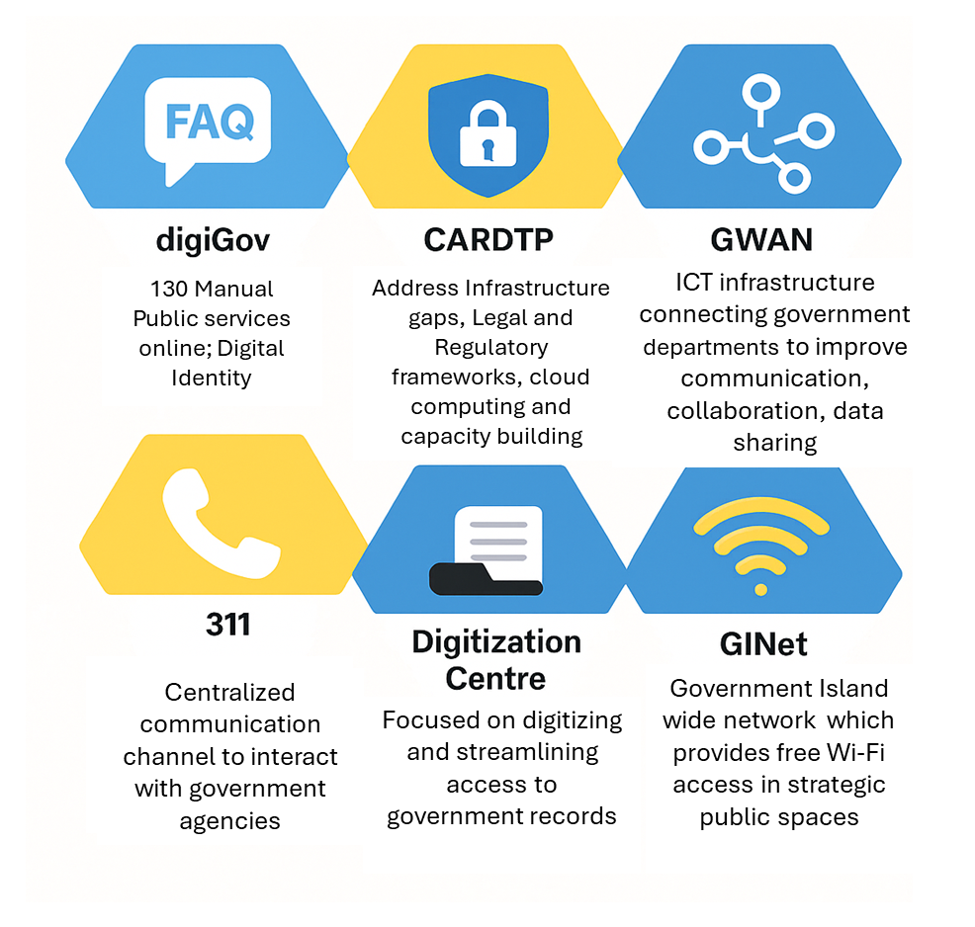
Revolutionizing Saint Lucia’s Digital Ecosystem

Slide 5
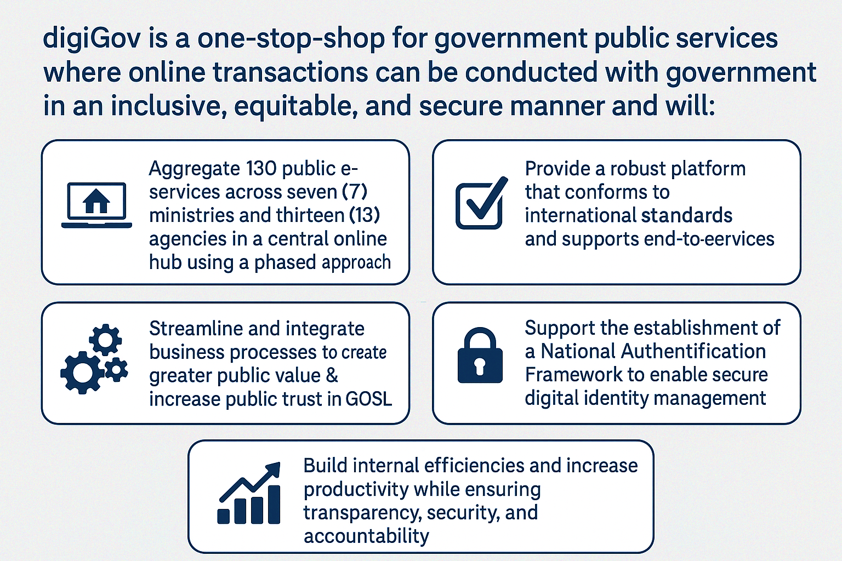
digiGov

Slide 6

Digital Citizen / Digital Identity
01
Karen Moss Berger defines digital citizenship as “ those who use the internet regularly and effectively”
Equity in Access
02
Access to ICT and ICT Resources for All
A digital citizen is a person utilizing information technology responsibly in order to engage with civil society and government.
A person who develops the skills and knowledge to effectively and ethically use the Internet and other digital technology, especially in order to participate responsibly in social and civic activities
E-Participation
Equal opportunity for all citizen to participate in the digital Economy
03
Data Only Once
Securely connect and exchange data amongst Go Systems to increase efficiency and transparency
80%
Digital ID
04
Securely identify users across all platform.

Slide 7
The National Authentication Framework (NAF)
The National Authentication Framework is a game-changer for government agencies, providing sophisticated identity verification across multiple databases. Its seamless integration with existing infrastructures ensures minimal disruptions while enhancing service provision, ultimately aiming to create a more efficient and responsive governmental ecosystem.
General Benefits of NAF for Citizens
Secure and Simplified Access: One digital identity for all government services
Faster Service Delivery: Reduced wait times and paperwork
Increased Privacy & Security: Protection of personal data against fraud
Convenience: 24/7 access to services from anywhere
Interoperability: Use the same authentication across multiple platforms
NAF Enhances Online Security
Protects against identity theft and fraud
Ensures secure authentication with multiple verification layers
Reduces risks of unauthorized access to personal records
Convenience & Accessibility
Access services from home without visiting government offices
Mobile and web-based authentication for flexibility
Reduces the need for multiple logins across different services
Improved Public Service Experience
Citizens receive faster approvals for government applications
Increased transparency in service requests and processing
Reduced duplication of records and information
NAF Empowers Digital Inclusion
Encourages broader participation in digital government services
Bridges the digital divide by ensuring everyone has a secure ID
Promotes trust and confidence in online transactions
Citizens Can Enroll in NAF
New Users: Required to complete the authentication process
Existing Users: Must update their data on the DigiGov platform
Easy Enrollment Process: Step-by-step guide to signing up

Slide 8
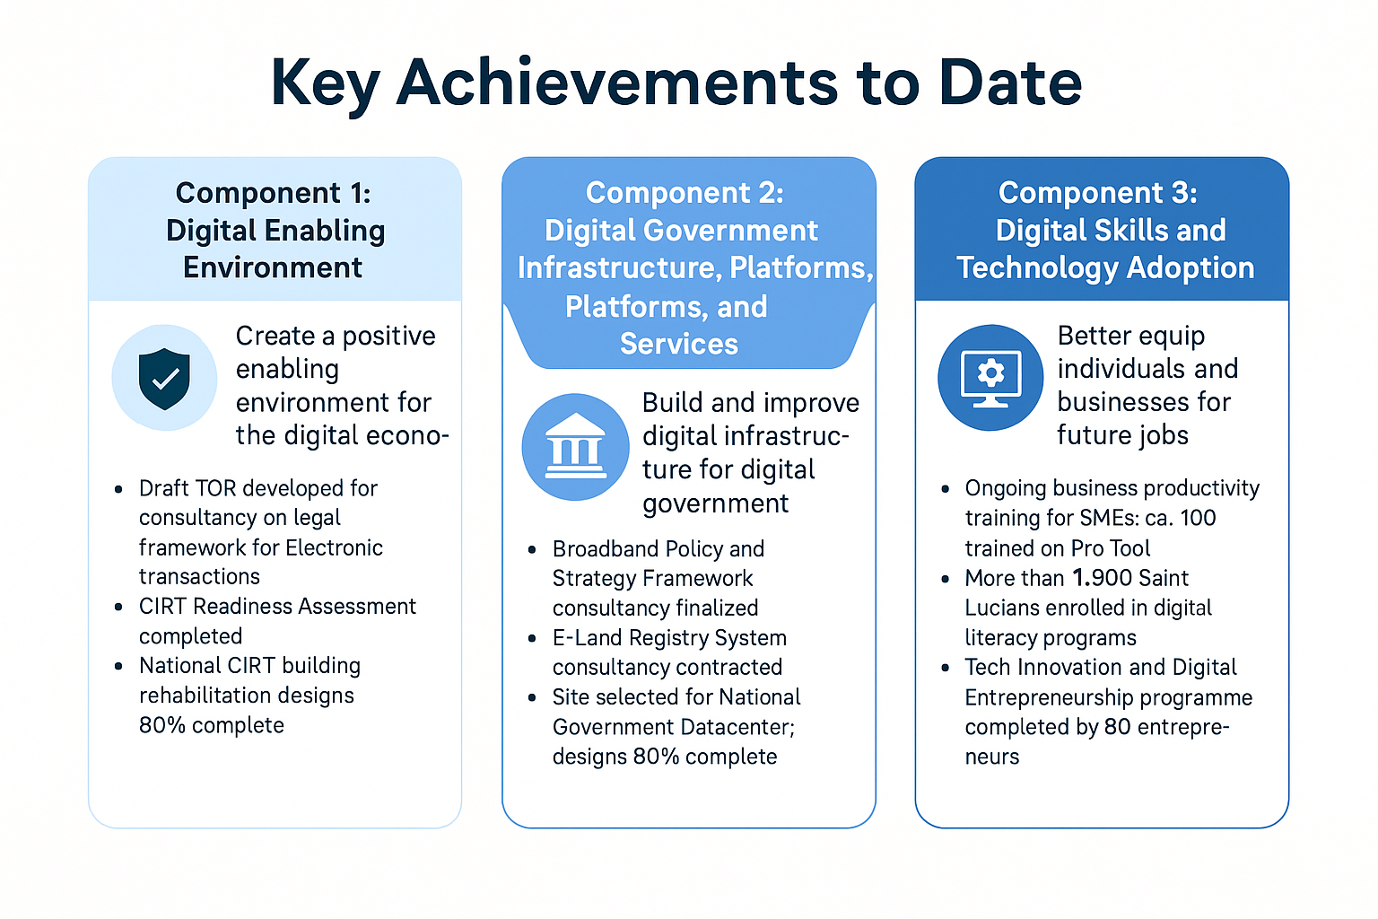
Caribbean Digital Transformation Project (CARDTP)
The Caribbean Digital Transformation Project (CARDTP) is a World Bank-funded initiative currently being implemented across Saint Lucia, Dominica, Grenada, and the Organization of Eastern Caribbean States (OECS). This project aligns with several national policies, including:
Supporting Saint Lucia's policy priorities of economic diversification, climate resilience, and sustainable development.
Aligning with Vision 2030, which aims to modernize the economy through digital transformation.
Supporting Saint Lucia’s Nationally Determined Contributions (NDCs) under the UN Framework Convention on Climate Change.

Slide 9
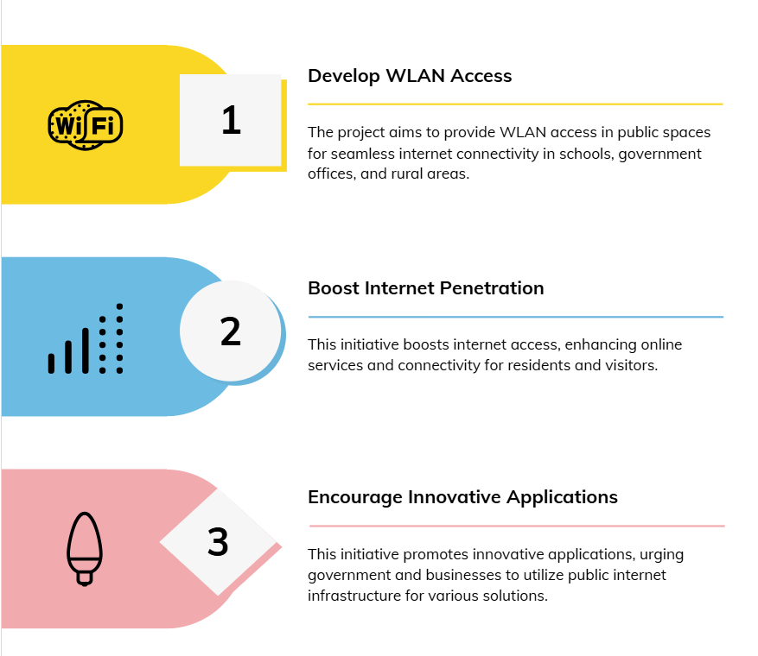

Government Island-wide Network (GINet)
Objectives

Slide 10

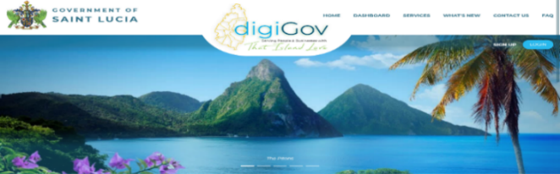
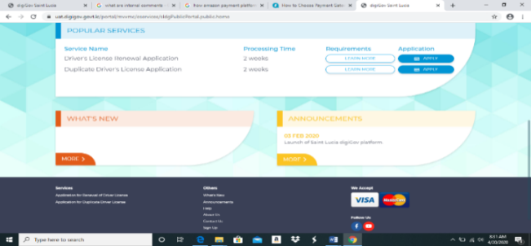
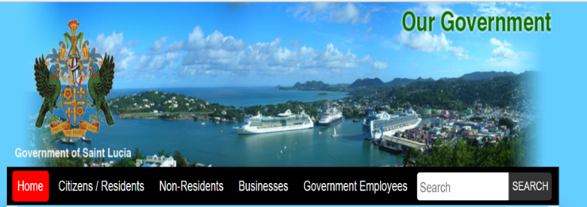
Contact Us…
Social Media
Facebook: https://www.facebook.com/digiGovStLucia/
Twitter: digigovslu (@digigovslu) / Twitter
Instagram: DigiGov Saint Lucia (@digigovslu) • Instagram photos and videos
WhatsApp
Email
YouTube: youtube.com/channel/UClhgG4U_pGwQ_MyLbFNymKg
digiGov WhatsApp: 758-384-6262
digiGov SBA Office: Tel: 468 8600 Address: Bourbon Street, Castries
digiGov user support email: digigovinfo@govt.lc
Transport user support email: transport.digigov@govt.lc
311 Contact Centre user support email: ccagents@govt.lc

