Slide 1
GDN Conversation Series: Understanding Credential and Skill Transparency and Interoperability with Credential Engine
Part III: A Technical Deep Dive Into CTDL, Implementation, and Applications
February 26, 2025

Slide 2
Credential Engine’s Open Technologies
Transforming credential information into linked open data means it can be shared, connected, and used across applications.
Credential Transparency Description Language (CTDL)
The only common language that describes key features of credentials, credentialing organizations, competencies, and quality assurance bodies. It is the description language for describing credentials and includes 1,200+ defined CTDL terms.
Credential Registry
More than a database, the Registry collects and connects credential data described with CTDL to support an open applications marketplace.
Notes:
Credential Transparency Description Language (CTDL): https://credentialengine.org/credential-transparency/ctdl/ Credential Regsitry: https://credentialengine.org/credential-transparency/credential-registry/

Slide 3
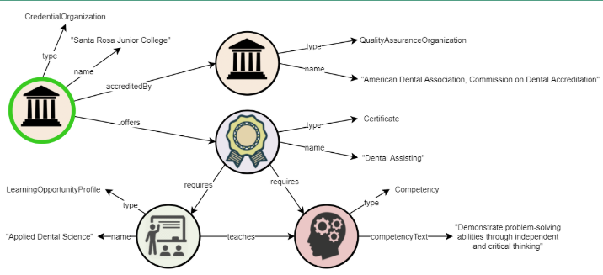
Credential Transparency Description Language
CTDL is a description language.
Family of schemas modeled on World Wide Web Consortium (W3C) specifications for the semantic web. Modeled as linked open data.
Every term in the CTDL is defined for semantic meaning.
Available for anyone to use under an open license.
Living language with rules for how it gets updated.
Meant to be used by anyone, anywhere in the world.
CTDL Handbook: https://credreg.net/ctdl/handbook
Technical Site:
https://credreg.net
Notes:
CTDL Handbook: https://credreg.net/ctdl/handbook
Technical Site:
https://credreg.net

Slide 4
Types of CTDL Data
Collection Aggregation of related resources. |  | Outcome Metric (Quantitative Data) Aggregate outcomes such as completion and employment rates, and earnings.
Competency Framework Logically related set of competencies. |  | Pathway A structured set of education and career pathway components to fulfill a goal or objective.
Concept Scheme A controlled vocabulary. |  | Progression Model Identifiable points along a developmental progression.
Course Single structured sequence of educational activities |  | Quality Assurance Actions Action taken to indicate issuance of quality assurance such as accreditation, regulation, or approval.
Credential Qualification, achievement, personal or organizational quality, or aspect of an identity typically used to indicate suitability. Complete list of Credential types. |  | Qualifications Framework Instrument for developing, classifying and issuing qualifications.
Industry Broad category of economic activities encompassing various sectors. Coming in 2025. |  | Rubric valuation tool used to assess performance, quality, and/or criteria.
Job Set of responsibilities based on work roles within an occupation as defined by an employer. |  | Support Service Resources and assistance that help people overcome barriers to succeed in their education and career goals.
Learning Opportunity Entity describing an educational or training opportunity. |  | Task Specific activity, typically related to performing a function or achieving a goal.
Learning Program Set of learning opportunities that leads to an outcome, usually a credential like a degree or certificate. |  | Transfer Value Prior learning value of a resource such as credits.
Occupation Profession, trade, or career field that may involve training and/or a formal qualification. |  | Work Role Collection of tasks and competencies that embody a particular function in one or more jobs.
Notes:
The links go to specific sections of the CTDL handbook https://credreg.net/ctdl/handbook

Slide 5
Credential Registry Publishing and Consuming Methods
The Credential Registry is a long-term data store. The architecture supports CTDL linked open data structure published as JSON LD and SKOS. All top-level entities, are linked via URIs that include a CTID, a property in the CTDL that is defined as a globally unique identifier. The Registry supports multiple publishing and consuming options. API keys are issued via the Credential Registry Publishing System to users who set up an account. Some options are for content specialists and some require developers. The options that require a developer use APIs and are noted below with an *. For all options, guidance is available via Credential Engine’s technical Site https://credreg.net or our Guidance Site https://guidance.credentialengine.org/.
Consuming Options
Slides: Registry Consuming Options
Registry Handbook: Registry Handbook
Get Record *
Search API *
Download *
Credential Finder Widget
Publishing Options
Badge Publisher Tool
Bulk Upload
Manual Entry
Pathway Builder
Registry Publishing Assistant API/ Slides: CredentialRegistryPublishingAsstAPI *
CTDL JSON LD Ingest *

Slide 6
For More Information
Phil Barker, CTDL Consultant to Credential Engine, Cetis LLP
phil.barker@pjjk.co.uk
Jeanne Kitchens, Chief Technology Services Officer
jkitchens@credentialengine.org
Website: credentialengine.org Email us: info@credentialengine.org Technical Information: credreg.net Credential Finder: credentialfinder.org Find @CredEngine on Social Media

